Slide 1


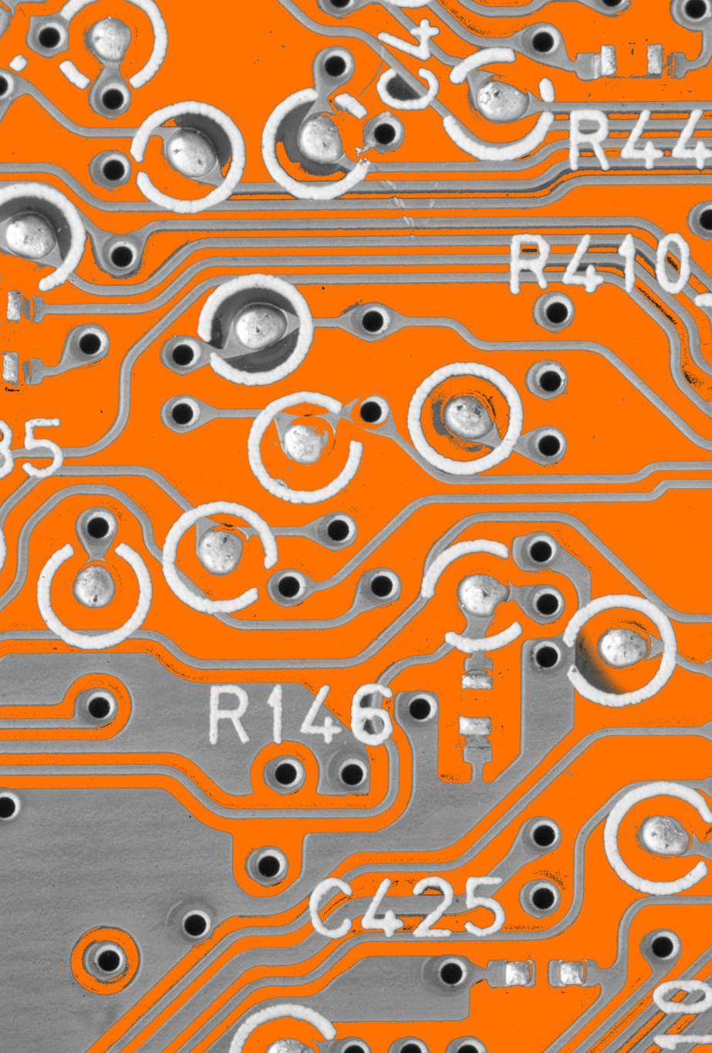
20XC32-MICROCONTROLLERS AND EMBEDDED SYSTEMS ACTUATORS
BY
21PC07 A.BHADRI NARAYANAN
21PC08 A.DHARSANN

Slide 2
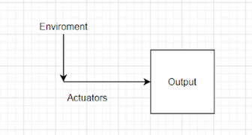
INTRODUCTION
An Actuator is a device that converts electrical signals into the physical events or characteristics. It takes input from the system and gives output to the environment.
In other words,In IoT, actuators enable a physical action based on the data that originates with one or more sensors.
Eg: Motor ,heater

Slide 3

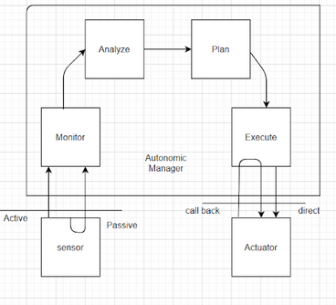
SENSOR ACTUATOR FLOW DIAGRAM

Slide 4
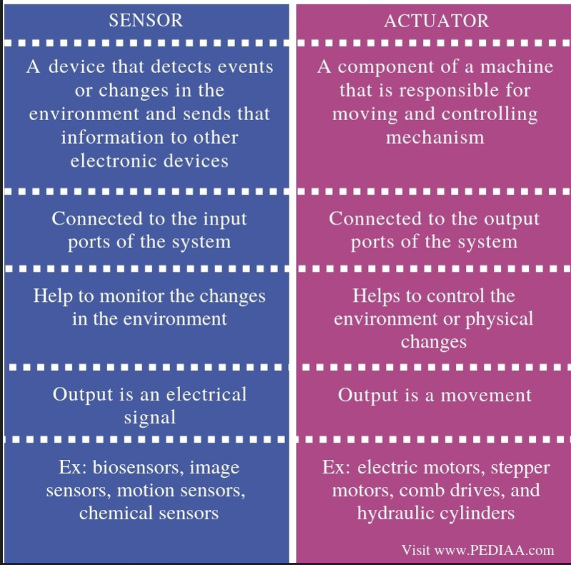
Difference between Sensors and actuators

Slide 5
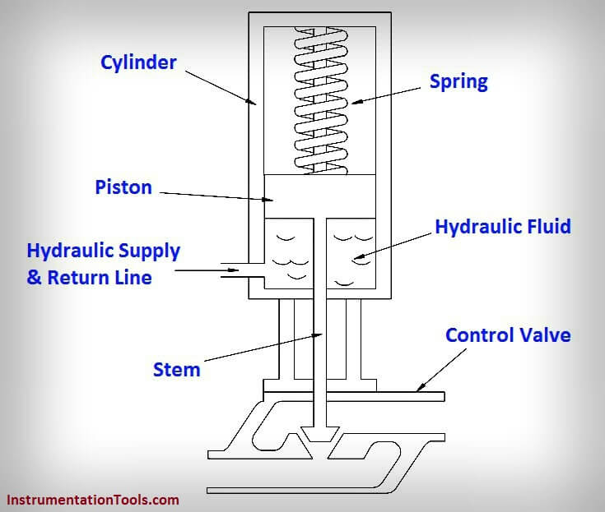
TYPES OF ACTUATORS
1.Hydraulilc actuators:
A hydraulic actuator uses hydraulic power to perform a mechanical operation.
They are actuated by a cylinder or fluid motor.
The mechanical motion is converted into rotary, linear or oscillatory motion, based on the need of the IoT device.
They are used in cranes ,winches and excavators.

Slide 6
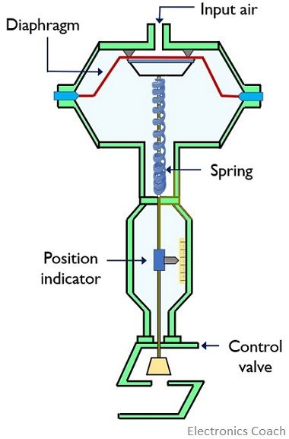
2.Pneumatic actuators:
A pneumatic actuator uses energy formed by vacuum or compressed air at high pressure to convert into either linear or rotary motion.
They are used in robotics.

Slide 7
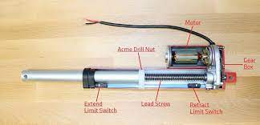
3.Electrical actuators:
An electrical actuator uses electrical energy ,is usually actuated by a motor that converts electrical energy into mechanical torque.
An example of an electrical actuator is a solenoid based electric bell.

Slide 8
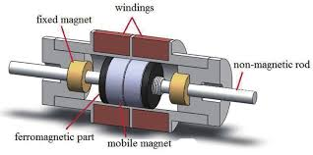
4.Magnetic actuators:
A MEMS magnetic actuator is a device that uses the microelectromechanical systems to convert an electric current into a mechanical output.
Magnetic actuators can be rotary or linear, and can have continuous or limited motion, the basic classes being moving-coil, moving-iron and moving-magnet.

Slide 9
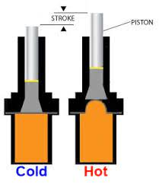
5.Thermal actuators:
A thermal actuator is a type of non-electric motor made of components such as a piston and a thermal sensitive material capable of producing linear motion in response to temperature changes.
The key element of a thermal actuator is the temperature-sensing material.
It is this material that expands and contracts based on the temperature of the device, causing the piston to move.
This material could be a liquid, gas, wax-like substance or other material that changes volume based on temperature.

Slide 10
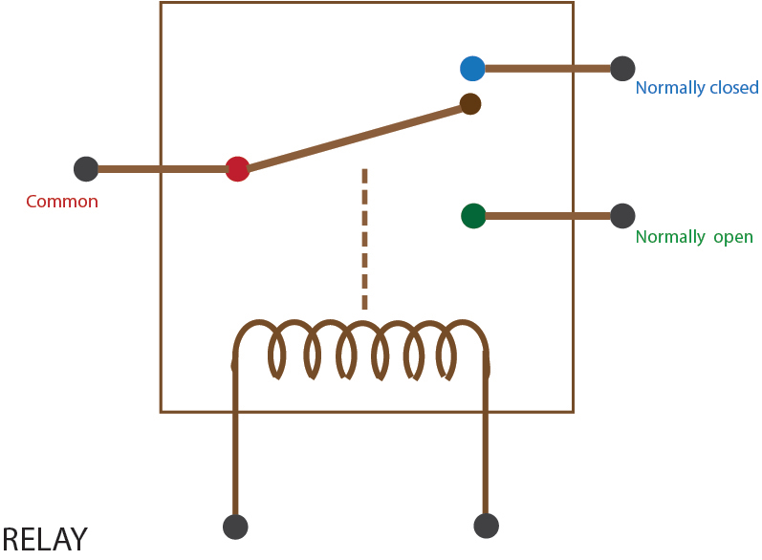
6.Relay actuators:
A relay is an electrically operated switch.
The majority of relays use electromagnets to mechanically operate a switch.
However, other operating principles can also be used, for example, solid-state relays.
It takes a relatively small amount of power to operate a relay coil.
That being so, it can still be used to control motors, heaters, lamps, or AC circuits.

Slide 11
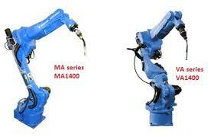
APPLICATIONS
Actuators have many applications in day to day life
Automatic door opening
Automatic valves(To control the flow of liquids)
In Car door lock window
In packaging label scanning and printing
Robotic welding machines and power hammer
All output devices in general have an actuators

Slide 12

USE OF IoT AND CLOUD COMPUTING IN EMBEDDED SYSTEMS
Nowadays, the actuators used in embedded systems interlinked networks of sensors, actuators, and processing devices are growing a huge internet of related computing sources, matters, and human beings.
Sensors and actuators in IoT work together to allow large-scale automation.
Internet of Things (IoT) and cloud computing has seen actuators used in embedded systems and every one of them has been conceived to cover a part of the aforementioned technologies.
Sensors collect the data and route it to the main control center in a classic IoT system. This is where the previously determined logic is used to make a decision.
It results in controlling the actuators according to the sensed input data. Therefore, IoT sensors and actuators work together but from different ends.

Slide 13
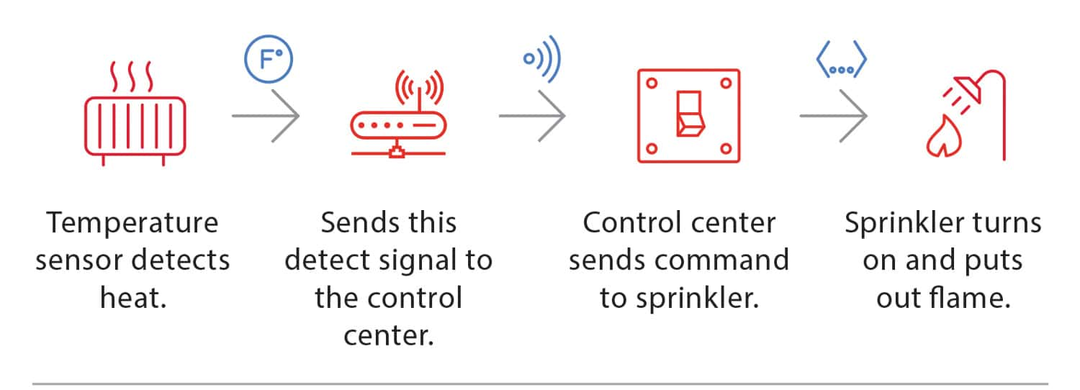
EXAMPLE

Slide 14
WIRELESS SENSOR AND ACTUATOR NETWORK
One of the most important applications of actuators is in networks
Wireless Sensors and Actuator Network consists of a group of sensors and actuators that are geographically distributed and interconnected by wireless networks.
Sensors gather information about the state of physical world. Actuators react to this information by performing appropriate actions.
WSANs thus enable cyber systems to monitor and
manipulate the behavior of the physical world. WSANs are growing at a tremendous pace,just like the exploding evolution of Internet.

Slide 15
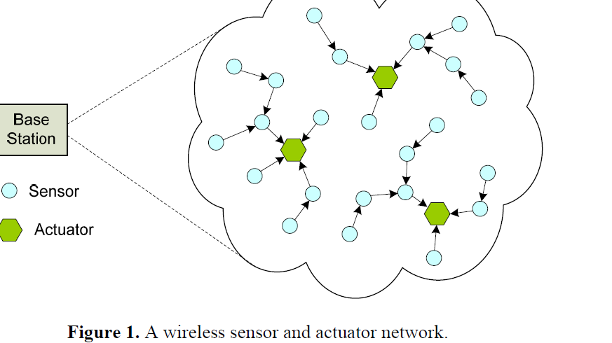
WSAN NETWORK

Slide 16
THANK YOU

